Slide 1
Reservoir Computing for Reinforcement Learning
Quentin Clark

Slide 2
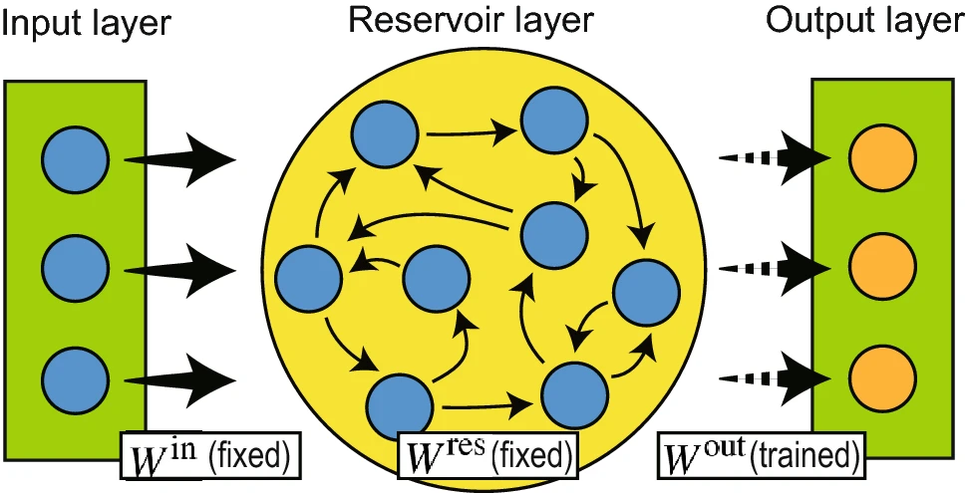
Reservoir Computing Basics
Notes:
Mention similarity to kernels in normal ML, except instead of being fixed they’re entirely randomly decided AND you don’t need to have the normal guarantees of the kernel function (namely, that you need to be able to write them in terms of dot products) and they’re more compatible with really big datasets

Slide 3







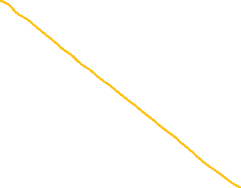

Toy Example: Classification

Slide 4
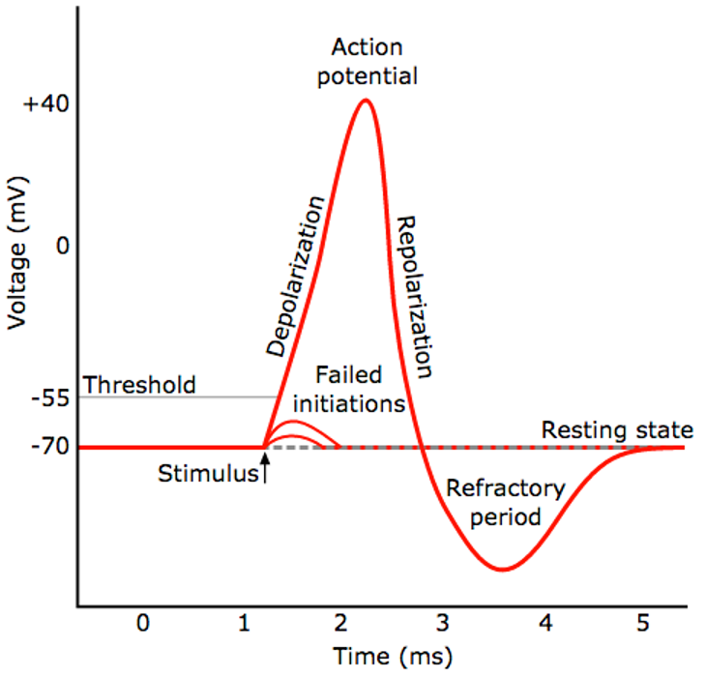
More RC Terminology
Liquid State Machine (LSM) – uses biologically inspired spiking
Some other guarantees about long-term behavior
Echo State Network (ESN) – like a traditional recurrent neural net
Extreme Learning Machine (ELM) – a RC system without recurrence

Slide 5
Why Reservoir Computing?
Not intuitive why learning on a linear layer would be better than backpropagation
Can immediately see you need more neurons for the same network capacity because your connections are entirely random
Making a good reservoir turns out to be non-trivial – requires more thought than just a random NN initialization and backprop
But first things first – what theoretical guarantees do they have?

Slide 6
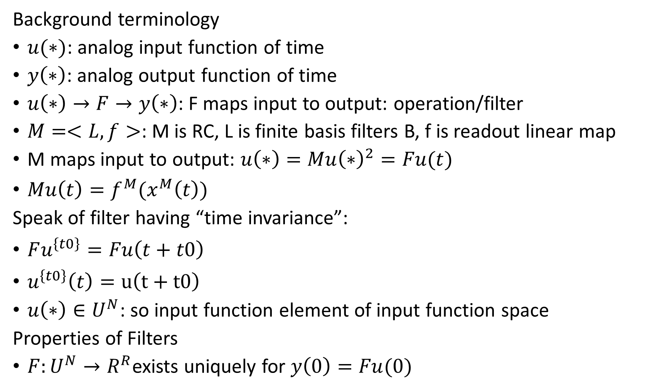
Reservoir Computers are Universal Function Approximators
Background terminology
$u(∗)$: analog input function of time
$y\left(∗\right)$: analog output function of time
$u\left(∗\right)→F→y\left(∗\right)$: F maps input to output: operation/filter
$M=<L,f>$: M is RC, L is finite basis filters B, f is readout linear map
M maps input to output: $u\left(∗\right)=Mu{\left(∗\right)}^{2}=Fu(t)$
$Mu\left(t\right)=f^{M}(x^{M}\left(t\right))$
Speak of filter having “time invariance”:
$Fu^{\left\{t0\right\}}=Fu\left(t+t0\right)$
$u^{\left\{t0\right\}}\left(t\right)=u\left(t+t0\right)$
$u\left(∗\right)∈U^{N}$: so input function element of input function space
Properties of Filters
$F:U^{N}→R^{R}$exists uniquely for $y\left(0\right)=Fu(0)$

Slide 7
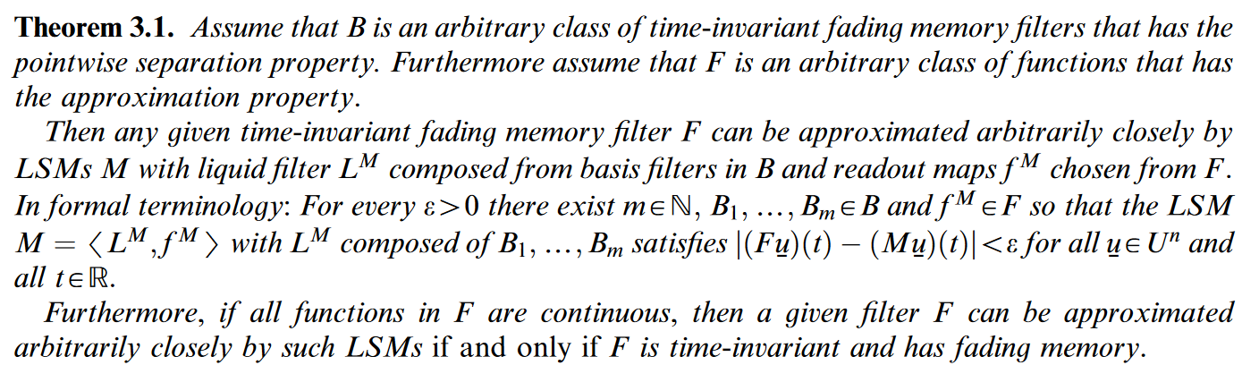
Proof: Theorem Proper
Note our filter must be time invariant – ie, shift invariant, and have fading memory
Same paper has similar proof for LSMs

Slide 8
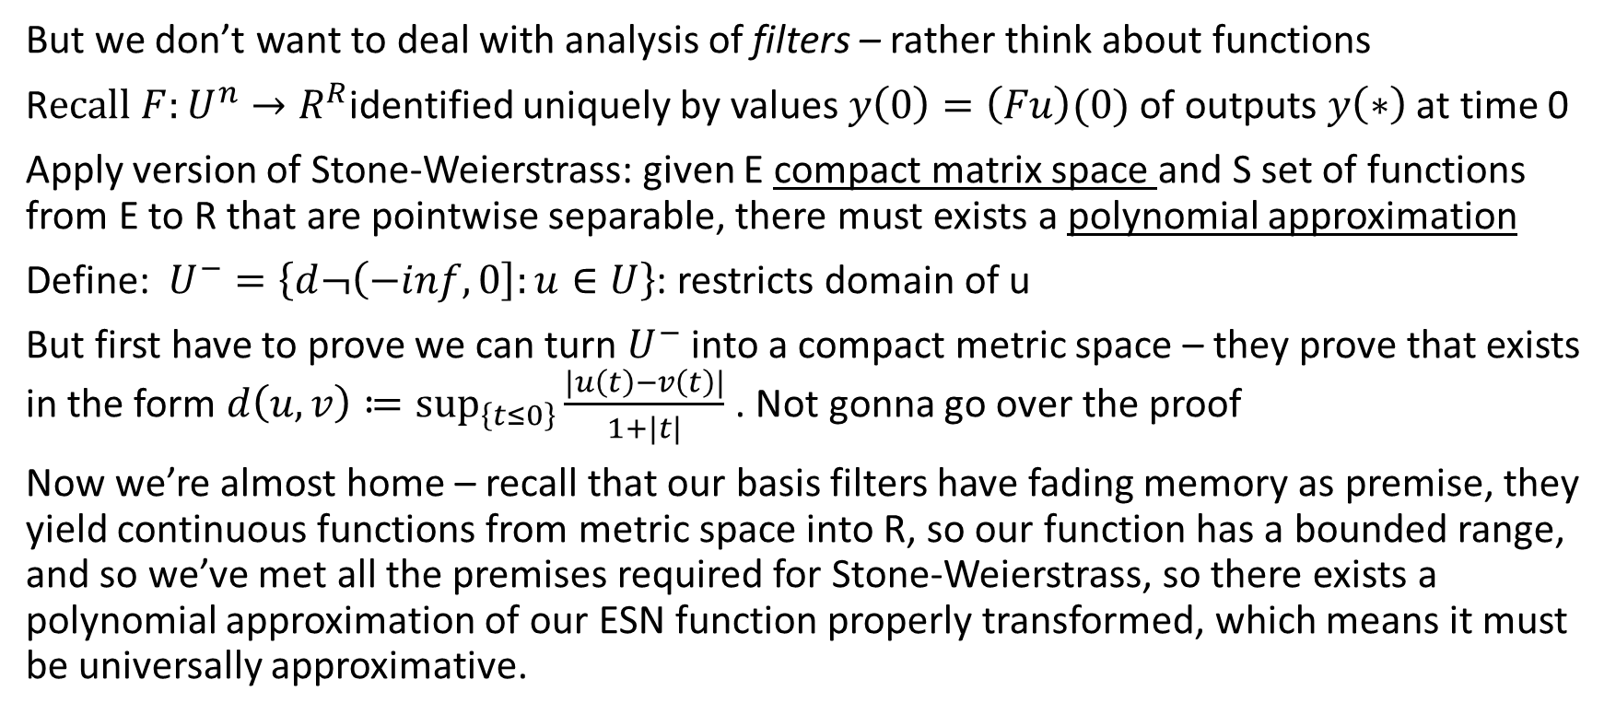
Proof
But we don’t want to deal with analysis of filters – rather think about functions
R$ecall F:U^{n}→R^{R}$identified uniquely by values $y\left(0\right)=\left(Fu\right)(0)$ of outputs $y\left(∗\right)$ at time 0
Apply version of Stone-Weierstrass: given E compact matrix space and S set of functions from E to R that are pointwise separable, there must exists a polynomial approximation
Define: $U^{−}=\left\{d¬\left(−inf,0\right]:u∈U\right\}$: restricts domain of u
But first have to prove we can turn $U^{−}$ into a compact metric space – they prove that exists in the form $d\left(u,v\right)≔\sup_{\left\{t≤0\right\}}{\frac{\left|u\left(t\right)−v\left(t\right)\right|}{1+|t|}}$ . Not gonna go over the proof
Now we’re almost home – recall that our basis filters have fading memory as premise, they yield continuous functions from metric space into R, so our function has a bounded range, and so we’ve met all the premises required for Stone-Weierstrass, so there exists a polynomial approximation of our ESN function properly transformed, which means it must be universally approximative.
Notes:
In other words: in order to identify or characterize a time-invariant filter F we just have to observe its output values at time 0; while its input varies over all functions u element of big U space.
Why is this important – replaces weird analysis of filter by functionals over real values instead of time!
What is temporal shift – shifting input function’s input by t0 causes temporal shift in output function by same amount
Note – I was previously under the impression polynomials DON’T have universal approxivness? So I have no clue what’s really going on
Another note – this sorta proves nothing because it just means your reservoir CAN make your data linearly seperatble, not that it will – the right random initializations/parameters hatter a lot! Big focus on modern RC literature

Slide 9
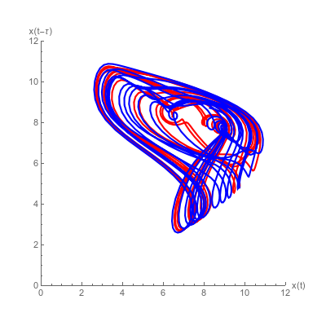
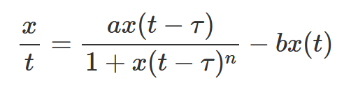
RC Benefits
Recurrent properties without time-rolled backpropagation – also eliminates vanishing gradients and training complexity
Hardware Neural Networks – they are possible with RC b/c you don’t need to do backpropagation – those are incredibly energy and space efficient
Sample Efficiency – compelling work that they are much more sample efficient than modern NN architectures – crucial for RL
Image: Mackey-Glass Series Representation
Notes:
Note – you get the the benefits of RNNs but also the downsides – upsides are only need partial state information/can capture a rich previous frame history as part of the state without needing to stack frames explicitly – reduces dimension of observed space! But downsides of catastrophic forgetting, “requiring” some initial warmup steps w/o training, and needing to reset network
Mackey-Glass: refer to a family of delay differential equations whose behavior manages to mimic both healthy and pathological behaviour in certain biological contexts, controlled by the equation's parameters. Both big RC libraries use this as their default learning thing, because its not super complicated but is a huge bitch to learn with a normal recurrent ne t

Slide 10
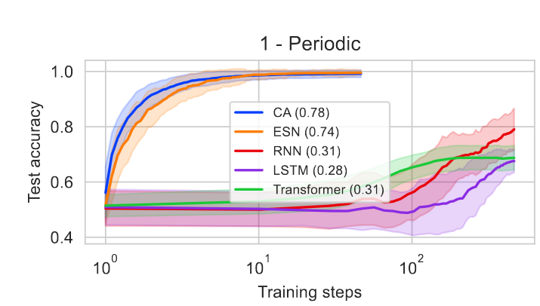
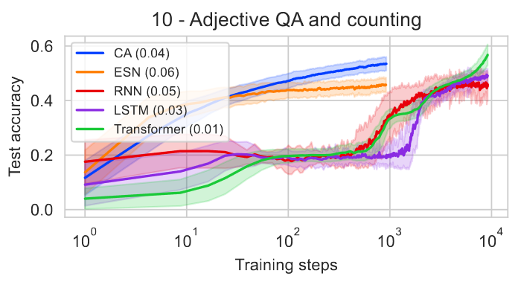
RC Sample Efficiency
Virtually always more efficient than SOTA deep learning approaches
But much lower performance ceiling, depending on task
Do these benefits apply for RL (different kind of task than supervised learning?

Slide 11
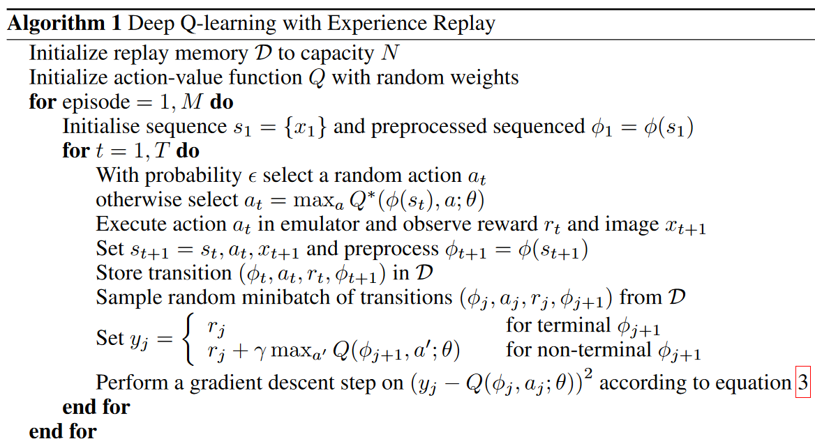
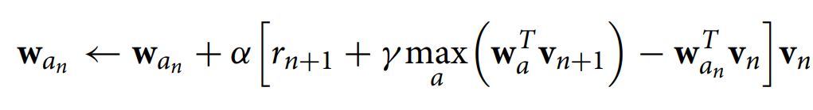

Algorithms for RCRL
Q-Learning
PPO/Policy Gradient
Not really sure – the paper said it did PPO but it looked like ACN under the hood

Slide 12
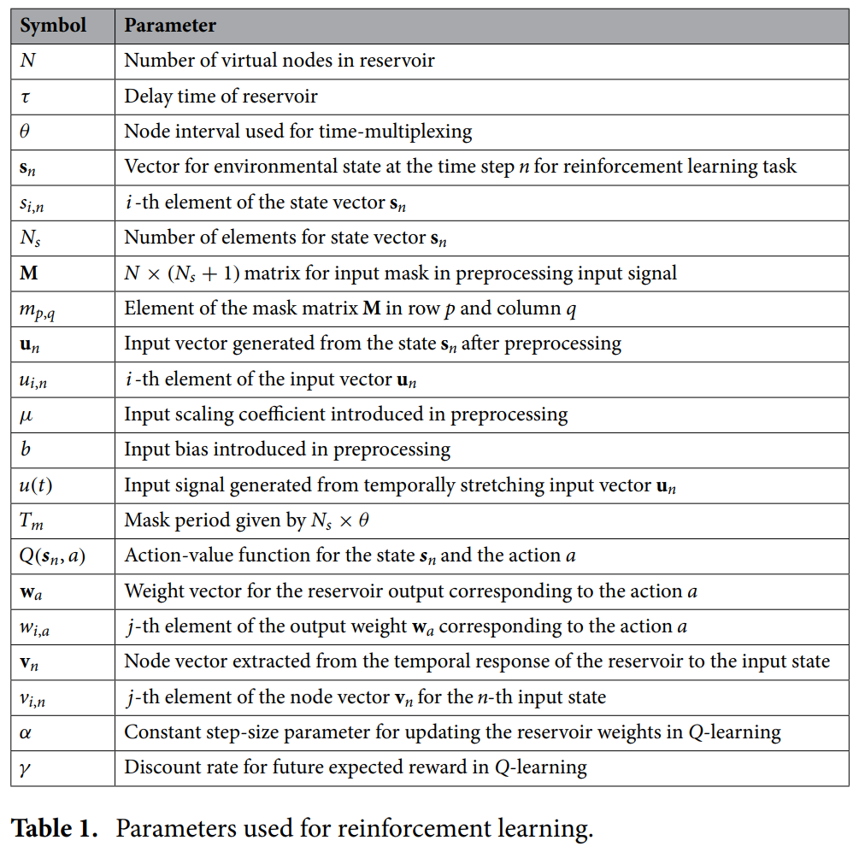


Why is RCRL hard?
TL:DR: because RL is hard, and RC gives you lots of new parameters and hyperparameters to worry about

Slide 13
State of the Field
Couple dozen papers, best of which are very new
Both Q-Value Based and Policy Gradient based solutions implemented
Weirdly large amount for edge computing spectrum analysis
Why? RC is great for edge computing applications
Used for robotics, Atari games, control tasks, couple of engineering applications
Weirdly large amount of work in Japan on this – almost all papers I read were from Japanese universities or research institutions
Maybe aging crisis reasons for this who knows

Slide 14
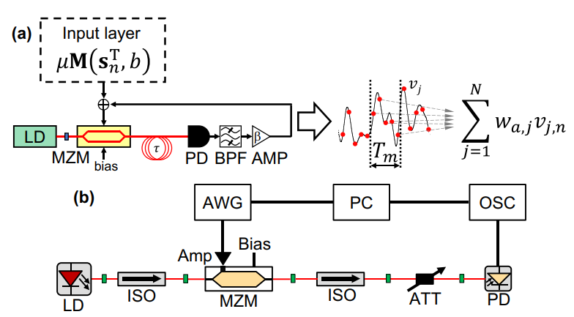
Highlight: Hardware Photonic Reservoir
Only paper I saw, and claims to be only one to do hardware RCRL
Trained Photonic ELM without some of the guarantees from before
Training a hardware RC is non-trivial
Did training processing in software, but you can do in hardware
Both had physical reservoir and simulation, but seemed to only train in hardware
Notes:
I found an earlier paper from 2018 that does hardware RC RL first, including a hardware readout layer with like, changing the angle of mirrors of a laser system, but its really a supervised task because it just predicts Mackey-Glass and the “rl” is just an online averaging step. That obviously does not count

Slide 15

what I did
Vanilla implementation of DQN w/ RC
Used ReservoirPy library
Support for both ELMs/ESNs, w/same training/model framework as HW4 code
Output linear layer trained w/least mean squares
ReLU activations
Probably put it on github at some point b/c RCRL repos are just not around I guess
Big takeaways
Very very very sensitive to learning rate – roughly degree of magnitude range where it will actually learn – using decaying alpha like in theory might actually be important
Training RCs online harder than offline

Slide 16
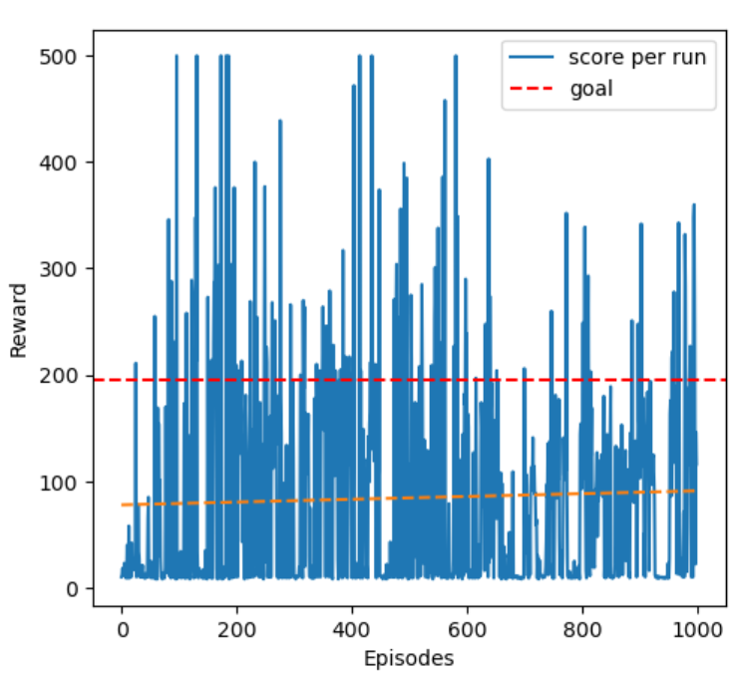
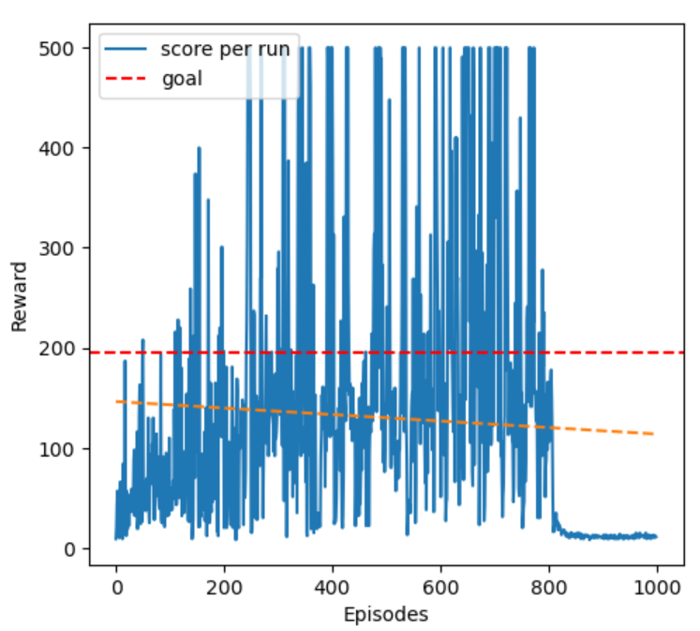
My results
Both had neurons s/t they trained for the same amount of wall clock time – all on CPU, DQN w/ 1 hidden layer ~200 neurons, ELM w/ ~1000 neuron reservoir
Generally – RCs are fiddly to get working online
Works a bit better than normal DQN
ELM>ESM for some weird reason
ELM very prone to catastrophic forgetting (clearly)
DQN
RC DQN w/ELM

